Slide 1
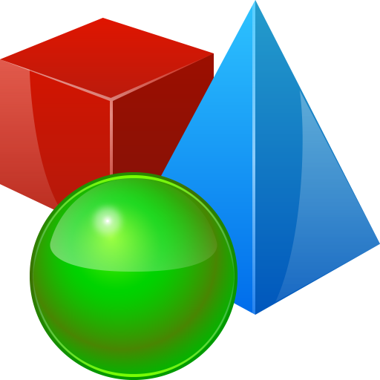
Objects and Classes
Enums, Objects, Class Definition & Members
SoftUni Team
Technical Trainers
Software University
https://softuni.bg

Slide 2
Table of Contents
Special Types – typedef, enum
Classes and Objects
Defining Classes and Using Objects
Fields, Methods, Constructors
Access Modifiers
public and private
Getters ang Setters

Slide 3
Questions
sli.do #cpp-fundamentals

Slide 4

Special Types
Typedef and Enumerations

Slide 5
Typedef
Typedefs allow creating aliases for existing types
Should be used within the problem's context
E.g.: map<string, vector<int> > to StudentScores
Syntax: similar to declaring a variable, place typedef in declaration
typedef string tenStrings[10];
tenStrings words = { "the", "quick", "brown", "fox", "jumps", "over", "the", "lazy", "dog", "!" };
typedef map<string, vector<int> > StudentScores;
StudentScores judgeAssignment2Scores;

Slide 6
Enumerations
Enumerations contain a fixed list of special constant values
All possible values are known and can be written in code
C++ has two enumeration types – enum and enum class
enum color { red, blue, pink };
color eyeColor = blue;
// same as color eyeColor = 1;
enum defines a list of named constant integers
enum class Color { red, blue, pink };
Color eyeColor = Color::blue;
/* Color eyeColor = 1 – invalid, compile time error */
enum class defines a new data type

Slide 7

Classes and Objects

Slide 8
Classes
In programming, classes provide the structure for objects
User-defined data types
Act as a template for objects of the same type
Definition contains the class “members”:
Fields, Methods, Constructors, Destructors
One class may have many instances (objects)
8

Slide 9
Objects
Any variable of a class-defined data type
Operator. (dot) is used for accessing members of an object
The instance is the object itself, which is created runtime
All instances have common behaviour
9

Slide 10
Defining Classes and Using Objects
Constructors, this-pointer, Methods

Slide 11
Defining Classes
Specification of a given type of objects from the real world
Members of a class are variables and functions
Access modifiers - where members can be accessed from
Class name
Key word
class Dice {
access_modifier: members… access_modifier:
…
};
Class body
Don’t forget the ; after definition
11

Slide 12
Defining Classes – Example
Person class
Age
Name
Height
name here is an object of the STL class string
#include<string>
class Person {
public:
std::string name;
int age;
double height;
};
int main() {
Person p;
return 0;
};
Access modifier

Slide 13
Using Objects
Creating a variable of a class data type
Objects follow the same rules as normal variables
Can be passed as copy to a function or by reference with &
Can be put into arrays, vectors, etc.
Accessing members through operator. (dot)
For access through an iterator, we use the operator->

Slide 14
Using Objects – Example
class Person {
class Body {
public:
double height;
double weight;
};
public:
string name;
int age;
Body body;
};
Person person;
person.name = "George Georgiev";
person.age = 25;
person.body.height = 1.82;
person.body.weight = 87;
Person otherPerson;
person.name = "Ana Ivanova";
person.age = 42;
person.body.height = 1.6;
person.body.weight = 54;

Slide 15
Constructors
Constructors initialize objects of a class
Follow same rules as functions, but without a return type
Can have overloads, default parameters, etc.
class Person {
string name; int age = 0; double height = 0;
Person(string pName, int pAge, double pHeight) {
name = pName;
age = pAge;
height = pHeight;
}
};
Class name
Parameters
Body

Slide 16
Calling Constructors
Can be called on declaration directly
Since C++11 can be called with {} brackets too:
Can be used to create objects to pass to a variable/function:
Person peter(“Peter Brown”, 31, 1.69);
Person peter{“Peter Brown”, 31, 1.69};
Person peter{“Peter Brown”, 31, 1.69};
Person ivan = Person(“Ivan Ivanov”, 12, 1.52));
vector<Person> people;
people.push_back(Person(“Ana Ivanova”, 43, 1.60));

Slide 17
The this Pointer
C++ gives us the this pointer to explicitly access class members
this points to whatever the current object is
Very useful in any method where parameters match the fields
There is a convention to always use this, even if not needed
Person(string name, int age, double height) {
this->name = name;
this->age = age;
this->height = height;
};

Slide 18
C++ Constructor Initializer List
Constructor body is always executed after a member creation
C++ constructors are typically written with initializer lists:
Executes before body
If a member is omitted, it is default-constructed (if possible)
This syntax is also immune to the member-hiding problem
ClassName(parameters) : member1(member1Parameters),
… memberN(memberNParameters) { }

Slide 19
Methods
Methods are functions declared inside a class
Follow the same rules as normal functions
Methods can access class fields and other members directly
Can read and write fields, call other methods, etc.
Can use this-> to explicitly refer to members

Slide 20
Methods – Example
A method for printing information
void printPersonInfo() {
cout << "name: " << this->name
<< ", age: " << this->age
<< ", height: " << this->body.height
<< ", weight: " << this->body.weight
<< endl;
}
void makePersonOlder(int years) {
this->age += years;
}
A method for aging up

Slide 21
Access Modifiers
Encapsulation, Getters and Setters

Slide 22
Encapsulation (1)
Do you see a problem in the following code?
We're updating the radius, but that doesn't update the area
const double PI = 3.14;
class Cirsle {
public:
double radius;
double area;
circle(double radius) : radius(rasius),
area(radius * radius * PI) {}
};
int main() {
Circle c(10);
c.radius = 20;
cout << c.area << endl;
return 0
}

Slide 23
Encapsulation (2)
Encapsulation – hiding internal state & operations from outside
And providing a controlled interface for interactions
You usually don't have direct access to a car's engine - but you have pedals, a gear lever, etc.
A class should keep its internal state correct
Hide its members so external code doesn't use them incorrectly
Have public methods that access members correctly
Encapsulation makes code simpler
You don't need to know how a specific class works to use it

Slide 24
public and private
Access modifiers
Control whether external code has member access
public – access both by code "outside" & "inside" the class
private – access ONLY to code "inside" the class
Every member has that access after an access modifier
Until another modifier is encountered
Access modifiers can set the access for multiple members

Slide 25
Getters and Setters
"Getter" & "Setter" – common names for some specific methods
Getter – public method returning value of private member
Can sometimes calculate what to return (e.g. calculate area)
Setter – public method assigning value of private member
Keeps internal state correct while giving access to external code
double getArea() { return this->area; }
void setRadius(double radius) {
this->radius = radius;
this->area = radius * raduis * PI;
}

Slide 26
Getters and Setters – Example (1)
class Circle {
private:
double radius;
double area;
public:
circle(double radius) : radius(radius),
area(radius * radius * PI) {}
double getRadius() { return this->radius; }
double getArea() { return this->area; }
void setRadius(double radius) {
this->radius = radius;
this->area = radius * radius * PI;
}
};

Slide 27
Getters and Setters – Example (2)
int main() {
Circle c(10);
cout << c.getArea() << endl;
c.setRaduis(20)
cout << c.getArea() << endl;
return 0;
}

Slide 28

Live Exercises

Slide 29

Summary
Typedefs allow shortening code by creating type aliases
Enumerations are types with user-defined values
Classes define templates for objects
Fields, Methods, Constructors, Destructors
Objects is an instance of a class
Classes should encapsulate their internal state
And provide methods for interaction
…
…
…

Slide 30
Questions?
Notes:
30

Slide 31












SoftUni Diamond Partners

Slide 32




SoftUni Organizational Partners

Slide 33
Trainings @ Software University (SoftUni)
Software University – High-Quality Education, Profession and Job for Software Developers
softuni.bg, softuni.org
Software University Foundation
softuni.foundation
Software University @ Facebook
facebook.com/SoftwareUniversity
Software University Forums
forum.softuni.bg
33
Notes:
33

Slide 34

License
This course (slides, examples, demos, exercises, homework, documents, videos and other assets) is copyrighted content
Unauthorized copy, reproduction or use is illegal
© SoftUni – https://softuni.org
© Software University – https://softuni.bg
Notes:
34

